Slide 1
Monopoly

Slide 2
Natural Monopoly
An industry is a natural monopoly when a single firm can supply a good or service to an entire market at a lower cost than could two or more firms.
Economies of scale arises over the relevant range of output.
Refer to dia below. A single firm can produce any amount at least cost. That is, for any given amount of output, a larger number of firms leads to less output per firm and higher average total cost.
Example of Natural Monopoly-distribution of water, Indian railways, Electricity
Size of the market determines the natural monopoly

Slide 3

Figure 1 Economies of Scale as a Cause of Monopoly
Cost
Average
total
cost
0
Quantity of Output
Copyright © 2004 South-Western

Slide 4
The profit maximization rule for monopolist
Quantity of customers (Q) | Price (P) | Total Revenue (TR) | Average Revenue (AR) | Marginal Revenue per 1000 customers (MR)
0 | 100 | 0 | 0
1000 | 90 | 90000 | 90 | 90000 (90)
2000 | 80 | 160,000 | 80 | 70000 (70)
3000 | 70 | 210,000 | 70 | 50000 (50)
4000 | 60 | 240,000 | 60 | 30000 (30)
5000 | 50 | 250,000 | 50 | 10000 (10)
6000 | 40 | 240,000 | 40 | -10000 (-10)
7000 | 30 | 210,000 | 30 | -30000 (-30)
8000 | 20 | 160,000 | 20 | -50000(-50)
9000 | 10 | 90,000 | 10 | -70000(-70)
10000 | 0 | 0 | 0 | -90000(-90)

Slide 5
Figure 3 Demand and Marginal Revenue Curves for a Monopoly
Price
€11
10
9
8
7
6
5
4
3
Demand
2
Marginal
(average
1
revenue
revenue)
0
–1
1
2
3
4
5
6
7
8
Quantity of Water
–2
–3
–4
Copyright © 2004 South-Western

Slide 6
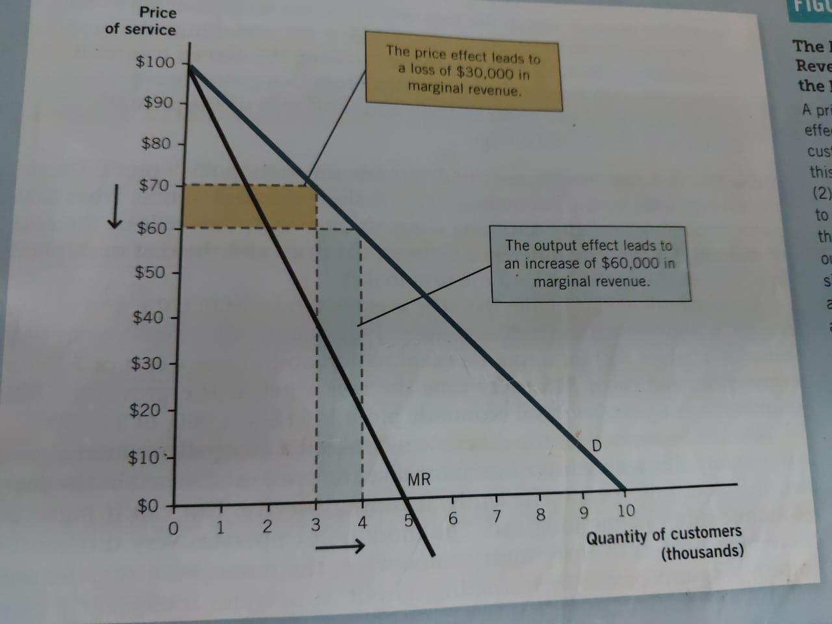

Slide 7
Price effect and output effect
From the above dia,
Price effect how the lower prices affects the revenue.
Initial price P=70 Monopolist Reduces the Price P=60
Initial Revenue is 70×3000= 210,000 New Revenue 60×4000 = 240,000.
At Price 70 he is selling to 3000 Customers and these 3000 customers will be paying 10 rs less compared to earlier price. Revenue loss is 3000×10 = 30000
At new price 60 he is selling to additional 1000 customers. Revenue gained is 1000×60 = 60000
Revenue gained is more than revenue loss. Price effect is small and monopolist can continue to reduce the price.

Slide 8
Output effect
Output effect is how the lower prices affect the number of customers.
Revenue gained is (1000 New Customers) 60×1000 = 60000
Lets calculate price effect and output effect at another price.
He is reducing the price from 30 to 20.
Price Effect-effect on Revenue-Revenue loss= 10×7000=70000
Output effect –effect on output-Revenue gain= 20×1000=20000

Slide 9
Figure 4 Profit Maximization for a Monopoly
Costs and
Revenue
2. . . . and then the demand
1. The intersection of the
curve shows the price
marginal-revenue curve
consistent with this quantity.
and the marginal-cost
curve determines the
B
profit-maximizing
Monopoly
quantity . . .
price
Average total cost
A
Marginal
Demand
cost
Marginal revenue
0
Q
Q_{MAX}
Q
Quantity
Copyright © 2004 South-Western

Slide 10
Figure 5 The Monopolist’s Profit
Costs and
Revenue
Marginal cost
Monopoly
E
B
price
Monopoly
Average total cost
profit
Average
total
D
C
cost
Demand
Marginal revenue
0
Q_{MAX}
Quantity
Copyright © 2004 South-Western

